Slide 1

School of Computer Engineering and Technology
Presentation for Rapid Prototyping-Civil Project
“Bamboo Garment Rack”
Students Name and Exam Seat Number:
Kshitija Vinod Lade (S204016)
Vaishnavi Ashok Jadhav (S204052)
Pratiksha Pradip Rale (S204014)
Guide:
Mr. Nikhil V. Bhalerao

Slide 2
Contents:
Introduction
Problem Statement and Motivation
Aim and Objectives
Planning
Methodology
Preliminary Design (Sketch)
Pretest Analysis (Material)
Design – Software
Analysis of Forces – Manual
Analysis of Forces – Coding
Cost Analysis
Results and Conclusion
References

Slide 3
Introduction:
Bamboo is a versatile, strong , renewable and environmentally friendly material. It is exceedingly strong for its weight and can be used both structurally and as a finish material. Bamboo has high tensile strength and has a good strength to weight ratio. It can resist forces and they are environment friendly, energy efficient and cost effective.
Our product is entirely designed using the bamboo material which contributes in the lightweightness and durability of the product.
Bamboo is used with the intentions to make the product strong and affordable.
The entire frame of the structure is made of bamboo which gives it the strength, durability and light weightness we need in our garment rack.
For making this product first there is a need for planning and designing of project ideas.
Our team planned for everything and prepared a sketch of the model which helped for making the prototype and undertaking all the tests on bamboo as well as the calculating the cost estimation we designed our product.

Slide 4
Problem statement and Motivation:
To design a feasible, cost effective and long lasting movable Bamboo Garment Rack with minimal hampering to the environment by conserving green resources ideally.
Sometimes it becomes very hideous to select the particular clothing from a bunch of different clothes which are disordered and unorganized.
Also while we are in hurry, we have to rush to place where our clothes are placed and look for the matching accessories to go with the clothing.
Considering all these difficulties, we have decided to build this bamboo garment rack which is useful for storing clothes in an organized manner.
The rack will also contain two shelves where we can put our shoes and accessories.
The skating roller design also makes it portable and the rack is also foldable so it can be kept anywhere as per the convenience.
It also will have 2 branches which can be used for hanging jackets, handbags, umbrellas, etc.
The hanging rod can be used to hang clothes and keep them properly organized.

Slide 5
Aim and Objectives:
The Aim of the project is to design a Garment Rack made out of bamboo which:-
Eases the problem of smaller room to place garments and other belongings.
Eliminates the wastage of time and money as it is quite affordable.
Indirectly creates new business opportunities.
The objective of the project is to design a product that is easy to produce using simple hand tools, which is economically viable and ecologically sustainable while improving the overall quality of facilities of the product in all aspects and to follow all the steps involved in the rapid prototyping and plan and design this prototype with proper testing, analysis and cost estimation.

Slide 6
Planning and Design:
Sr. No. | Name of Activity. | Description. | Date.
1. | Idea of the product | We decided the product based on our everyday chores. | 30th Jan
2. | Primary design of the product | Designing of the product was done to analyze various components and parts based on their use. | 6th Feb
3. | Joints analysis | We decided that fish mouth joint is mostly suitable for our product as it is easy and looks good. | 13th Feb
4. | Cost Estimation | Cost was calculated based on the raw materials required to hire engineers. Both direct and indirect cost is calculated. | 13 Mar
5. | Truss Analysis | We did the truss analysis based on the total joints and members in our structure. We calculated the type of truss with the help of the formula m= 2j-3 where m is the number of members and j is the number of joints | 27th Mar
6. | Virtual Prototype design | We designed a virtual prototype of our product with the help of Fusion 360. | 10th Apr

Slide 7
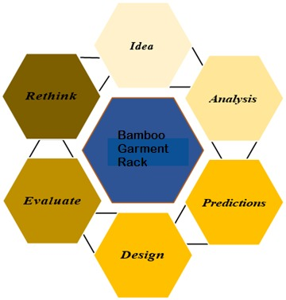
Methodology:
We followed the plan, and figured out how much we have progressed towards our project goal and how far we are from our destination, in other words we followed the basic methodology for our project:-
Develop objectives/Goals to achieve.
Develop ideas to meet this goals.
Determine resources needed to implement ideas.
Create a timeline.
Tracking and assessment method.
Finalize plan.
Design and evaluate.

Slide 8
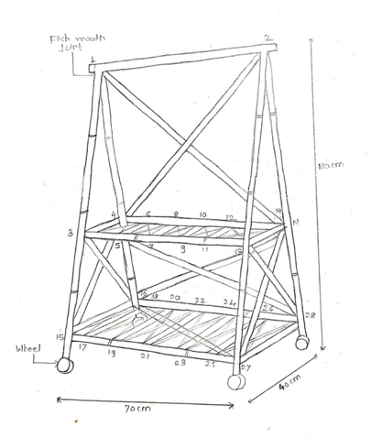
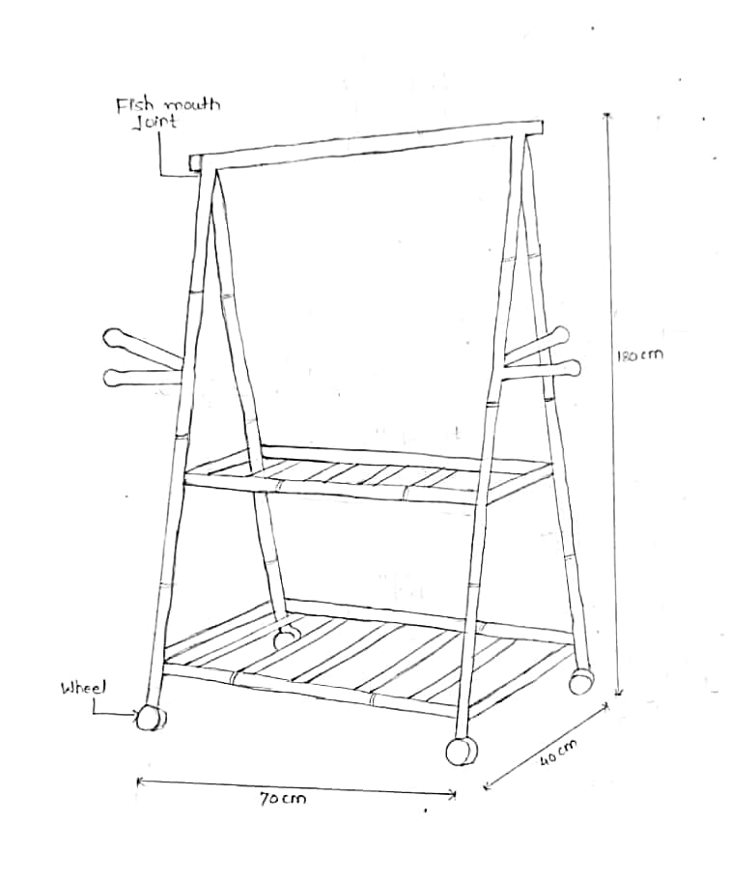
Preliminary Design (Sketch):

Slide 9
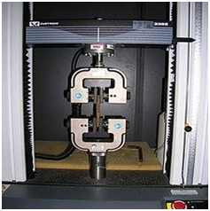
Pre-Test Analysis:
Tensile Strength Test:
Tensile strength test is used to measure the force required to break the bamboo and the extent to which the bamboo is elongated before breaking was carried out.
It is used to check how much tension the bamboo can hold.
Based on this test, we can decide for which purpose we can use this bamboo.
We can segregate the bamboo based on its tensile strength.
The failure pattern like the splitting end grip failure, ultimate and yield strength of the bamboo can be determined.

Slide 10
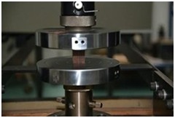
2. Compression Strength Test:
The maximum compressive strength of bamboo is evaluated by testing the bamboo culms in a universal testing machine.
It is used to check how much pressure the bamboo can hold.
Based on this we can decide for which purpose we can use this bamboo.
It can determine the failure of the bamboo specimen in a compression test which generally occurs either as the deformation of the surface having contact with plates or in the form of cracking.
We can segregate the bamboo based on its compression strength.

Slide 11
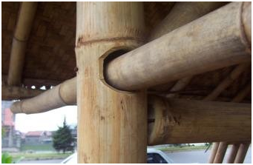
3. Joint Test:
It is used to check the strength of joints of bamboo by this test.
The theoretical strength and that obtained in experiments of filled bamboo joints were compared and the bamboo is selected for making furniture, etc.
Based on this we can decide for which purpose we can use this bamboo joint.
We can segregate the bamboo based on its joint strength.
Different faults in the bamboo joint can be identified easily with this test.

Slide 12
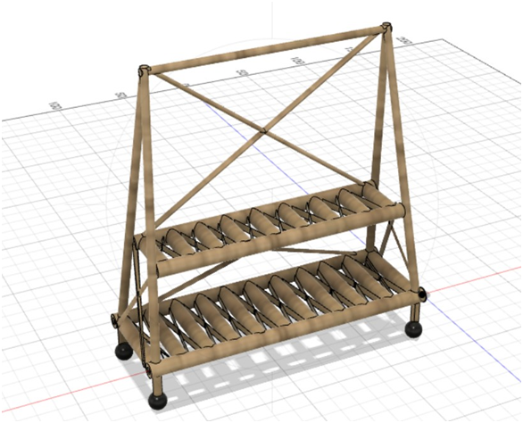
Virtual Prototype (CAD MODEL):

Slide 13
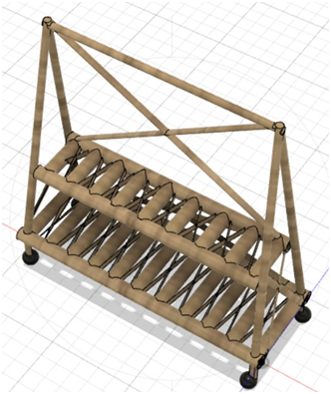
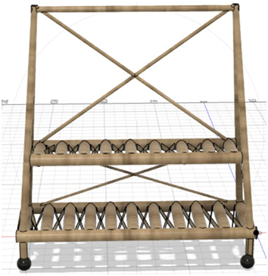

Slide 14
Truss Analysis:
Total Number of Members : 22
Total Number of Joints : 28
According to the Formula : M = 2*J - 3
2*28 - 3 = 53
22 != 53
M < 2*J - 3
Hence the structure is Deficient.

Slide 15
Making into Perfect Truss
Total Number of Members : 53
Total Number of Joints : 28
According to the Formula : M = 2*J - 3
2*28 - 3 = 53
53 = 53
Hence the structure is Perfect.

Slide 16
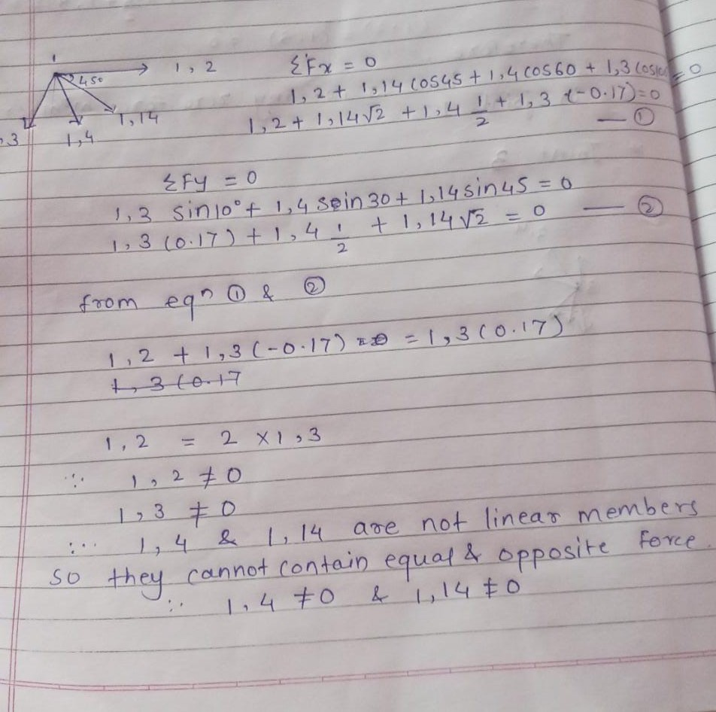
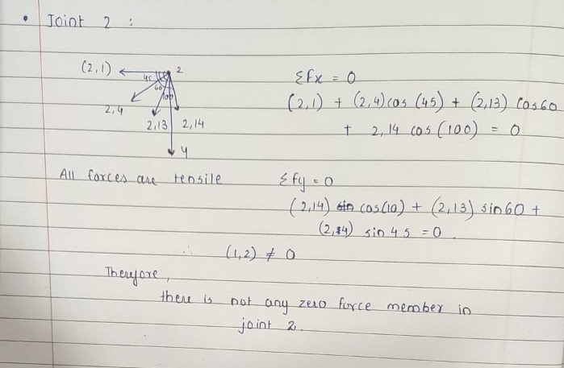
Force Analysis:

Slide 17
Analysis Of Forces-Coding:
#include<iostream> #include<math.h>
using namespace std;
class bamboo_garment_rack
{
public:
const float G=9.8; int members=53;
float breaking_tension=700; bool rack_hanger()
{
double cloth_weight, tension;
}

Slide 18
cout<<"\nEnter the weight of clothes (In grams): "; cin>>cloth_weight;
cloth_weight= cloth_weight/1000; tension=(members+cloth_weight)*G; if(tension<breaking_tension)
{
}else
{
}
return false;
return true;
void Joint_forces()
{
float fx,fy;
fx=45*cos(45) - 45*cos(60)+cos(10);

Slide 19
fy=45*sin(10) - 45*sin(30)+sin(45);
cout<<"\nForces on X axis due to joints are: "<<fx<<endl;
cout<<"\nForces on Y axis due to joints are: "<<fy<<endl;
}
void cloth_force_base()
{
double fx,fy,cloth_force;
cout<<"\nEnter the Force Applied by the clothes : ";
cin>>cloth_force;
fx=((cloth_force*cos(45))+(cloth_force/2*cos(60))+cos(10))*-1;
fy=((cloth_force/2*sin(10))+(cloth_force*sin(30))+sin(45))*-1;
cout<<"\nForces of X axis are: "<<fx<<" N"<<endl;
cout<<"\nForces on Y axis are: "<<fy<<" N"<<endl;
}
void truss_analysis()
{

Slide 20
int m,j,ans;
cout<<"\nEnter the number of members: ";
cin>>m;
cout<<"\nEnter the number of joints: ";
cin>>j;
ans=2*j-3; if(ans==m)
{
cout<<"\nThe structure is a perfect truss!";
}
else if(ans<m)
{
cout<<"\nThe structure is deficient";
}
else
{
}
cout<<"\nThe structure is efficient";
}
};

Slide 21
int main()
{
bamboo_garment_rack rack;
int choice,ch=1;
while(ch!=0)
{
cout<<"\n1. Garment rack hanger\n2. Forces on base of rack\n3. Forces due to joints\n4. Truss analysis\n\n Enter your choice: "<<endl;
cin>>choice;
switch(choice)
{
case 1:
bool b;
b=rack.rack_hanger();
if(b)
{
cout<<"\nThe hanger will break";
}
else
{

Slide 22
cout<<"\nThe hanger will not break";
}
break;
case 2: rack.cloth_force_base();
break;
case 3: rack.Joint_forces();
break;
case 4:
rack.truss_analysis();
break;
default:
cout<<"Invalid choice"<<endl;
}
cout<<"\nDo you want to continue? (0/1): ";
cin>>ch;
}
return 0;
}

Slide 23
Cost Analysis:
Direct Cost:
1. Cost of raw materials:
Bamboo: Total Bamboo Used = (2m * 4) + (1m *5) + (0.4m * 4)
= 8m + 5m + 1.6m
= 14.5m
Cost = total bamboo used x rates per m
= 14.5*(24rs/m)
=Rs. 348
Screws: 18*(2rs/piece) = Rs. 36
Wheels: 4*(9rs/piece)= Rs. 36
Total Cost = 348+36+36
= Rs. 420

Slide 24
2. Labour cost:
Skilled labour = Rs 400/day
Our project only requires labour for approximately 1 days (8 hours). Total labour cost = Rate of skilled labour x no. of working days
= Rs 400/day x 1 days
= Rs 400

Slide 25
Indirect Cost:
1. Hiring of Machine
Machine | Cost/Day(Rs.) | No. of days used | Total cost(Rs.)
Chop saw | 25 | 2 | 50
Hand Grill | 15 | 2 | 30
Grinder | 15 | 1 | 15
Hammer | 10 | 2 | 20
Chisel | 5 | 2 | 10
Total Cost = Rs.125

Slide 26
2. Electricity Cost :
Approximately 18 units will be consumed during production of truss.
Cost of one unit is Rs.9
Total electricity cost = 18 units x Rs 9
= Rs. 162
3. Engineer/designer:
The fees of the engineer /designer is 2% of the total cost of the project.
So far the cost of the project is Rs 2500
Cost of engineer/designer = 2500×0.02
= Rs 50

Slide 27
Total Cost Estimation:
Type of cost. | Elements. | Cost.
Direct | Material | Rs. 420
 | Labour | Rs. 400
Indirect | Hiring of machines | Rs. 125
 | Engineer/designer | Rs. 50
 | Electricity | Rs. 162
 | Total | Rs. 1157
Thus, the cost analysis done above is done with the approximation of time and material required to make the crippler Climber. Actual cost of the production of this prototype may vary close to this projected value depending on the market scenario.

Slide 28
Results and Conclusion:
In this subject of civil prototyping we learnt the basics about the civil structure and truss structure. We also came across civil engineering structures, their strength, their joining and using. From this course we come to know that what is trending in current and what will be trending in future.
In this prototype we learn about fabrication, analysis and testing of the prototype.
Bamboo is a more economical material than steel.
We learned how to perform various tests like compression test, joint test and tension test.
Design of our structure was successfully made using software like Autodesk
Fusion 360.

Slide 29
References:
1. https://ieeexplore.ieee.org/document/7016225.
2.https://www.researchgate.net/publication/224453645_Online_detection_and_sorting_syst em_of_bamboo_strip_based_on_visual_servo.
3. https://www.youtube.com/watch?v=HvoOqcjoUvA.
4.http://mechanicsmap.psu.edu/websites/5_structures/method_of_joints/methodofjoinht ml#:~:text=The%20Method%20of%20Joints,forces%20in%20a%20truss%20structue.

Slide 30
THANK YOU!

